Slide 1
恶意代码分析与防治技术 第13章 数据加密与解密
王志
zwang@nankai.edu.cn
南开大学 网络空间安全学院
2023-2024学年

Slide 2
本章知识点
The Goal of Analyzing Encoding Algorithms
Simple Ciphers
重点：XOR、BASE64
Common Cryptographic Algorithms
难点：信息熵Entropy
Custom Encoding
Decoding
重点：自解密Self-decoding

Slide 3
The Goal of Analyzing Encoding Algorithms

Slide 4

主观题
10分
计算机病毒为什么要使用数据加密算法？
正常使用主观题需2.0以上版本雨课堂
作答

Slide 5
Reasons Malware Uses Encoding
Hide configuration information
Such as C&C domains
Save information to a staging file
Before stealing it
Store strings needed by malware
Decode them just before they are needed
Disguise malware as a legitimate tool
Hide suspicious strings

Slide 6
The Goal
Identify the encoding functions
Understand the encoding method
Decode malware secrets
Using the encoding knowledge

Slide 7
多选题
10分
恶意代码通常会对哪些数据进行加密？
A
恶意代码的配置信息
B
偷取的数据、文件等
C
恶意代码用到重要字符串
D
伪装成正常软件所需要隐藏的信息
提交

Slide 8
多选题
10分
破解恶意代码的数据加密需要完成哪些工作？
A
识别数据加密函数
B
分析数据加密方法
C
找到恶意代码的文件特征码
D
解密被加密的数据
提交

Slide 9
Simple Ciphers

Slide 10
主观题
10分
简单数据加密有哪些方法？为什么要使用简单加密方法？
正常使用主观题需2.0以上版本雨课堂
作答

Slide 11
Why Use Simple Ciphers?
They are easily broken, but
They are small, so they fit into space-constrained environments like exploit shellcode
Less obvious than more complex ciphers
Low overhead, little impact on performance
These are obfuscation, not encryption
They make it difficult to recognize the data, but can't stop a skilled analyst

Slide 12
Caesar Cipher
Shift each letter forward 3 spaces in the alphabet
ABCDEFGHIJKLMNOPQRSTUVWXYZ
DEFGHIJKLMNOPQRSTUVWXYZABC
Example
ATTACK AT NOON
DWWDFN DW QRRQ

Slide 13
XOR
0 xor 0 = 0
0 xor 1 = 1
1 xor 0 = 1
1 xor 1 = 0
Uses a key to encrypt data
Uses one bit of data and one bit of the key at a time

Slide 14
主观题
10分
对字符串 “HI” 进行XOR数据加密，密钥是0x3c, “HI”的ASCII码是0x48 0x49，XOR加密后的数据是？
正常使用主观题需2.0以上版本雨课堂
作答

Slide 15
XOR
Example: Encode HI with a key of 0x3c
HI = 0x48 0x49 (ASCII encoding)
Data: 0100 1000 0100 1001
Key: 0011 1100 0011 1100
Result: 0111 0100 0111 0101

Slide 16
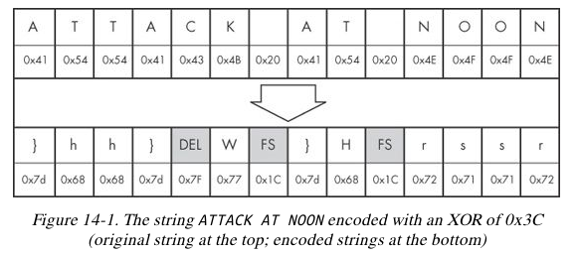

Slide 17
XOR Reverses Itself
Example: Encode HI with a key of 0x3c
HI = 0x48 0x49 (ASCII encoding)
Data: 0100 1000 0100 1001
Key: 0011 1100 0011 1100
Encode it again
Result: 0111 0100 0111 0101
Key: 0011 1100 0011 1100
Data: 0100 1000 0100 1001
0 xor 0 = 0
0 xor 1 = 1
1 xor 0 = 1
1 xor 1 = 0

Slide 18
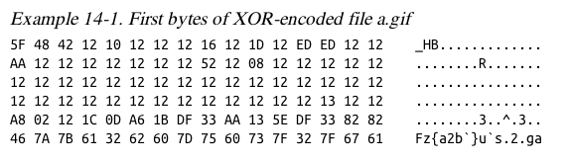
Brute-Forcing XOR Encoding
If the key is a single byte, there are only 256 possible keys
Error in book; this should be "a.exe"
PE files begin with MZ

Slide 19
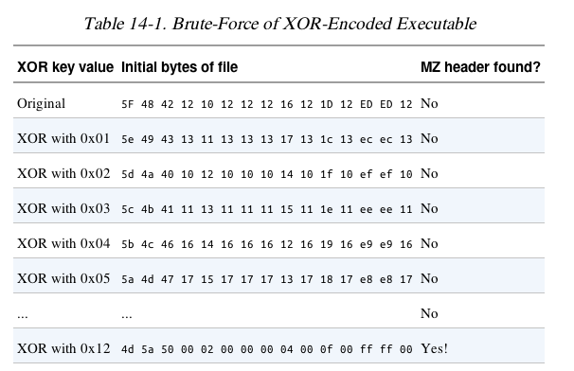
MZ = 0x4d 0x5a

Slide 20
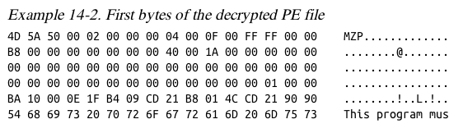

Slide 21
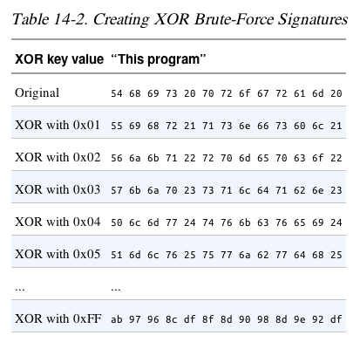
Brute-Forcing Many Files
Look for a common string, like "This Program"

Slide 22
XOR and Nulls
A null byte reveals the key, because
0x00 xor KEY = KEY
Obviously the key here is 0x12

Slide 23
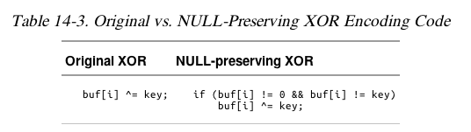
NULL-Preserving Single-Byte XOR Encoding
Algorithm:
Use XOR encoding, EXCEPT
If the plaintext is NULL or the key itself, skip the byte

Slide 24
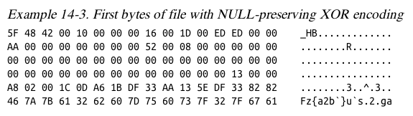

Slide 25
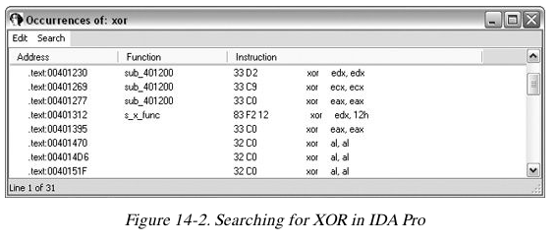
Identifying XOR Loops in IDA
Small loops with an XOR instruction inside
Start in "IDA View" (seeing code)
Click Search, Text
Enter xor and Find all occurrences

Slide 26
Three Forms of XOR
XOR a register with itself, like xor edx, edx
Innocent, a common way to zero a register
XOR a register or memory reference with a constant
May be an encoding loop, and key is the constant
XOR a register or memory reference with a different register or memory reference
May be an encoding loop, key less obvious

Slide 27
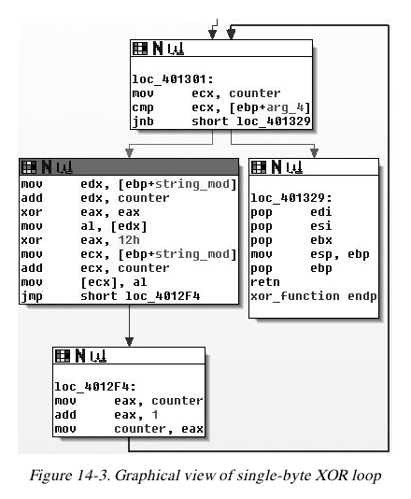

Slide 28
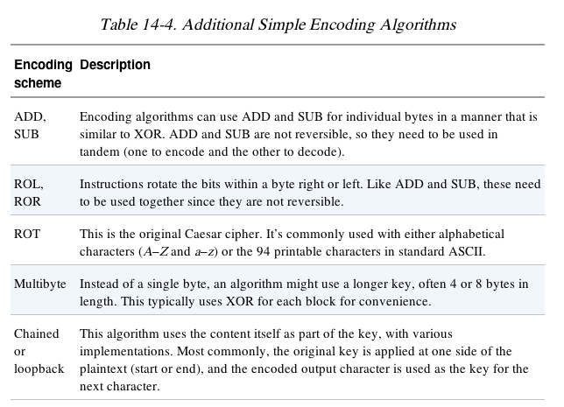

Slide 29
主观题
10分
讨论：大家经常见到Base64算法，尤其在Web和email的数据文件中，Base64算法是否可以应用到恶意代码的数据加解密？
作答

Slide 30
Base64
Converts 6 bits into one character in a 64-character alphabet
There are a few versions, but all use these 62 characters:
ABCDEFGHIJKLMNOPQRSTUVWXYZ
abcdefghijklmnopqrstuvwxyz
0123456789
MIME uses + and /
Also = to indicate padding

Slide 31
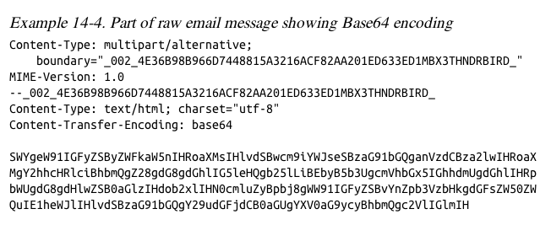

Slide 32
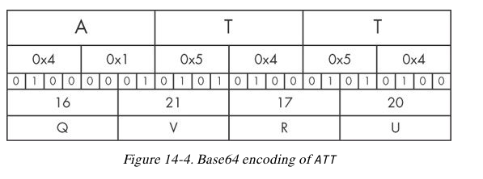
Transforming Data to Base64
Use 3-byte chunks (24 bits)
Break into four 6-bit fields
Convert each to Base64

Slide 33
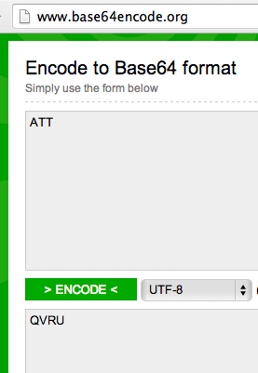
base64encode.org base64decode.org
3 bytes encode to 4 Base64 characters

Slide 34
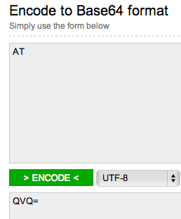
Padding
If input had only 2 characters, an “=” is appended

Slide 35
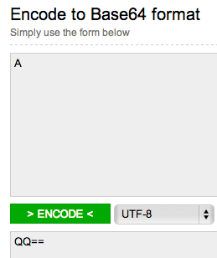
Padding
If input had only 1 character, == is appended

Slide 36
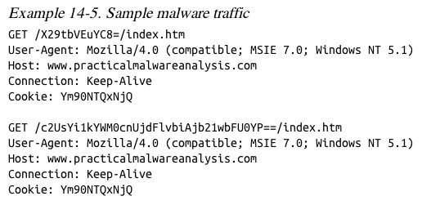
Example
URL and cookie are Base64-encoded

Slide 37
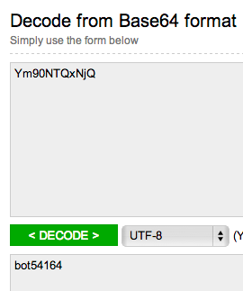
Cookie: Ym90NTQxNjQ
This has 11 characters—padding is omitted
Some Base64 decoders will fail, but this one just automatically adds the missing padding

Slide 38
Finding the Base64 Function
Look for this "indexing string"
ABCDEFGHIJKLMNOPQRSTUVWXYZabcdefghijklmnopqrstuvwxyz0123456789+/
Look for a lone padding character (typically =) hard-coded into the encoding function

Slide 39
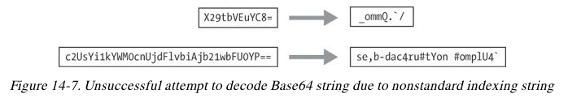
Decoding the URLs
Custom indexing string
aABCDEFGHIJKLMNOPQRSTUVWXYZbcdefghijklmnopqrstuvwxyz0123456789+/
Look for a lone padding character (typically =) hard-coded into the encoding function

Slide 40
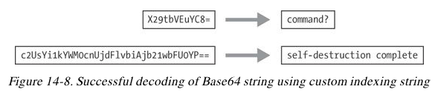

Slide 41
多选题
10分
以下哪些指令可以被恶意代码用于数据加密和解密？
A
XOR
B
ADD、SUB
C
ROL、ROR
D
MOV
提交

Slide 42
多选题
10分
恶意代码常使用哪些简单的数据加解密方案？
A
凯撒密码
B
XOR
C
Base64
D
MD5
提交

Slide 43
Common Cryptographic Algorithms

Slide 44
主观题
10分
有哪些常见的高强度加密算法? 恶意代码中使用这些算法有哪些优点和缺点？
正常使用主观题需2.0以上版本雨课堂
作答

Slide 45
Cryptography
Cryptography vs. Cipher ?
Cryptography applications?

Slide 46
Strong Cryptography
Strong enough to resist brute-force attacks
Ex: SSL, AES, etc.
Disadvantages of strong encryption
Large cryptographic libraries required
May make code less portable
Standard cryptographic libraries are easily detected
Via function imports, function matching, or identification of cryptographic constants
Symmetric encryption requires a way to hide the key

Slide 47
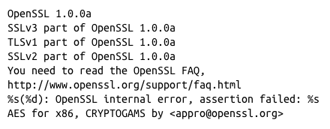
Recognizing Strings and Imports
Strings found in malware encrypted with OpenSSL

Slide 48
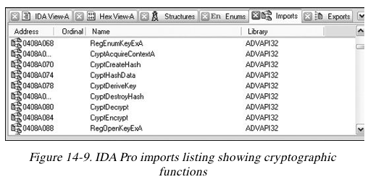
Recognizing Strings and Imports
Microsoft crypto functions usually start with Crypt or CP or Cert

Slide 49
Searching for Cryptographic Constants
IDA Pro's FindCrypt2 Plug-in
Finds magic constants (binary signatures of crypto routines)
Cannot find RC4 or IDEA routines because they don't use a magic constant
RC4 is commonly used in malware because it's small and easy to implement

Slide 50
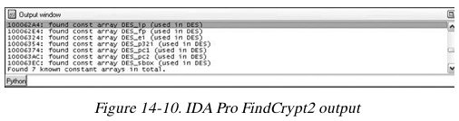
FindCrypt2
Runs automatically on any new analysis
Can be run manually from the Plug-In Menu

Slide 51
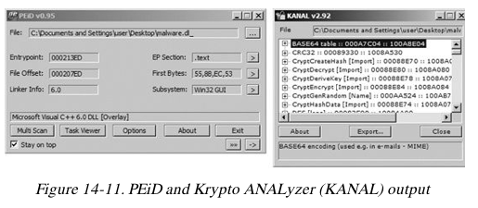
Krypto ANALyzer (PEiD Plug-in)
Download from link Ch 13d
Has wider range of constants than FindCrypt2
More false positives
Also finds Base64 tables and crypto function imports

Slide 52

Entropy
Entropy measures disorder
最大熵定理，等概率场的平均不确定性最大
The number of occurrences of each byte from 0 to 255
If all the bytes are equally likely, the entropy is 8 (maximum disorder)
If all the bytes are the same, the entropy is 0

Slide 53
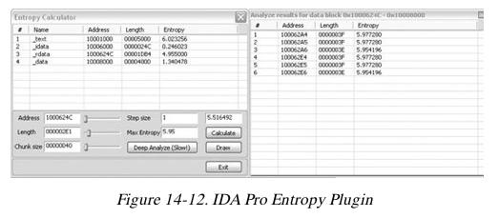
Searching for High-Entropy Content
IDA Pro Entropy Plugin
Finds regions of high entropy, indicating encryption (or compression)

Slide 54
Recommended Parameters
Chunk size: 64 Max. Entropy: 5.95
Good for finding many constants,
Including Base64-encoding strings (entropy 6)
Chunk size: 256 Max. Entropy: 7.9
Finds very random regions

Slide 55
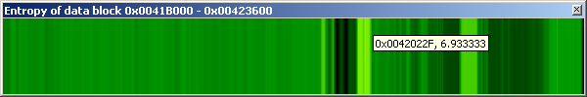
Entropy Graph
IDA Pro Entropy Plugin
Download from link Ch 13g
Use StandAlone version
Double-click region, then Calculate, Draw
Lighter regions have high entropy
Hover over graph to see numerical value

Slide 56
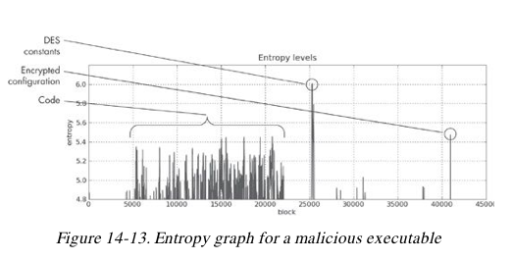

Slide 57
多选题
10分
使用库函数进行数据加密有哪些缺点？
A
增加恶意代码体积
B
降低移动性
C
容易被发现
D
对称加密需要隐藏密钥
提交

Slide 58
多选题
10分
有哪些检测恶意代码是否使用库函数加密数据的方法?
A
Entropy
B
加密相关的常量
C
加密相关函数的名字
D
加密相关库的名字
提交

Slide 59
单选题
10分
Entropy值高的区域还是低的区域有可能是加密数据？
A
Entropy值高的区域
B
Entropy值低的区域
提交

Slide 60
Custom Encoding

Slide 61
主观题
10分
讨论：基于标准的加密方法，恶意代码是否可以设计自定义的加密方法？ 自定义的加密方法有哪些优点？
作答

Slide 62
Homegrown Encoding Schemes
Examples
One round of XOR, then Base64
Custom algorithm, possibly similar to a published cryptographic algorithm

Slide 63
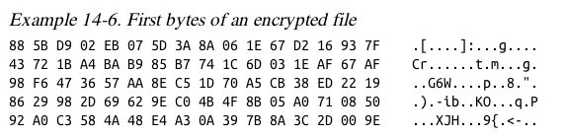
Identifying Custom Encoding
This sample makes a bunch of 700 KB files
Figure out the encoding from the code
Find CreateFileA and WriteFileA
In function sub_4011A9
Uses XOR with a pseudorandom stream

Slide 64
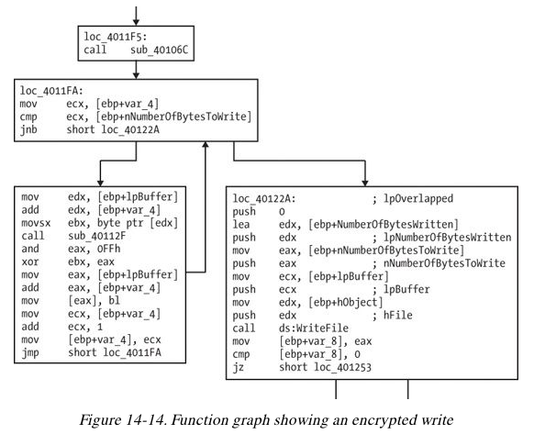

Slide 65
Advantages of Custom Encoding to the Attacker
Can be small and nonobvious
Harder to reverse-engineer
key
decryption function

Slide 66
多选题
10分
自定义的数据加密算法比使用标准库函数加密有哪些优点？
A
增加逆向工程的难度
B
结合简单加密方案，执行速度更快，体积小
C
可以隐藏密钥
D
不能直接找到解密函数
提交

Slide 67
Decoding

Slide 68
主观题
10分
针对恶意代码使用的数据加密方法，逆向分析恶意代码时有哪些有效的解密方法？
作答

Slide 69
Two Methods
Reprogram the functions
Use the functions in the malware itself

Slide 70
Self-Decoding
Stop the malware in a debugger with data decoded
Isolate the decryption function and set a breakpoint directly after it
BUT sometimes you can't figure out how to stop it with the data you need decoded

Slide 71
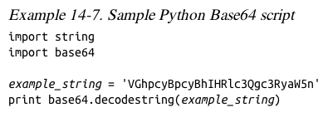
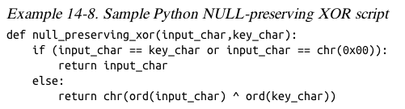
Manual Programming of Decoding Functions
Standard functions may be available

Slide 72
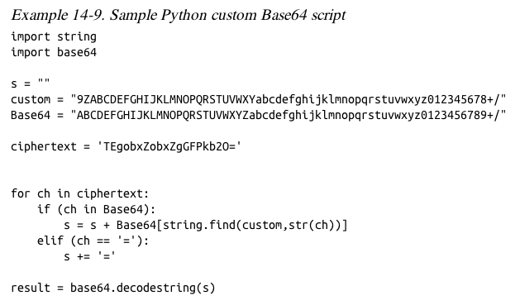

Slide 73
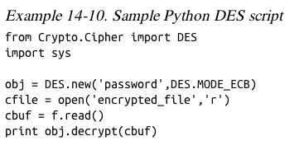
PyCrypto Library
Good for standard algorithms

Slide 74
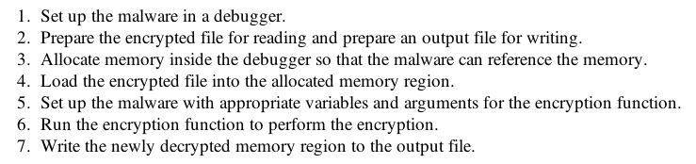
How to Decrypt Using Malware

Slide 75
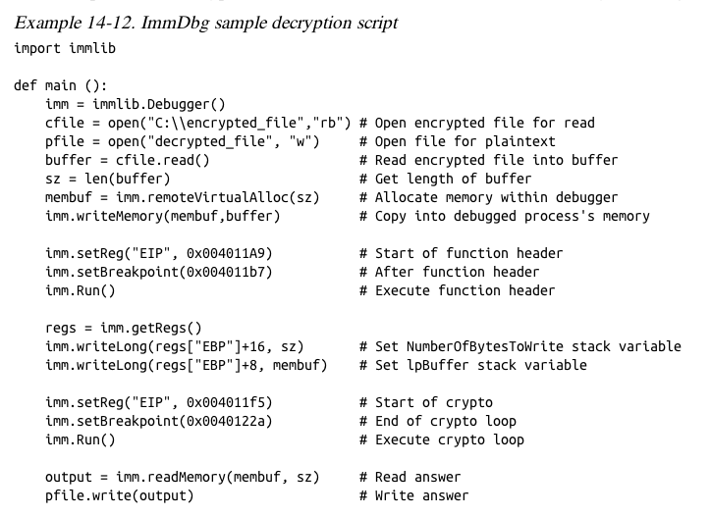

Slide 76
多选题
10分
针对恶意代码的加密数据，有哪些可行的解密方法？
A
等恶意代码自解密Self-decoding
B
编写解密函数
C
通过插装控制恶意代码来解密
D
暴力破解
提交

Slide 77
勒索病毒

Slide 78
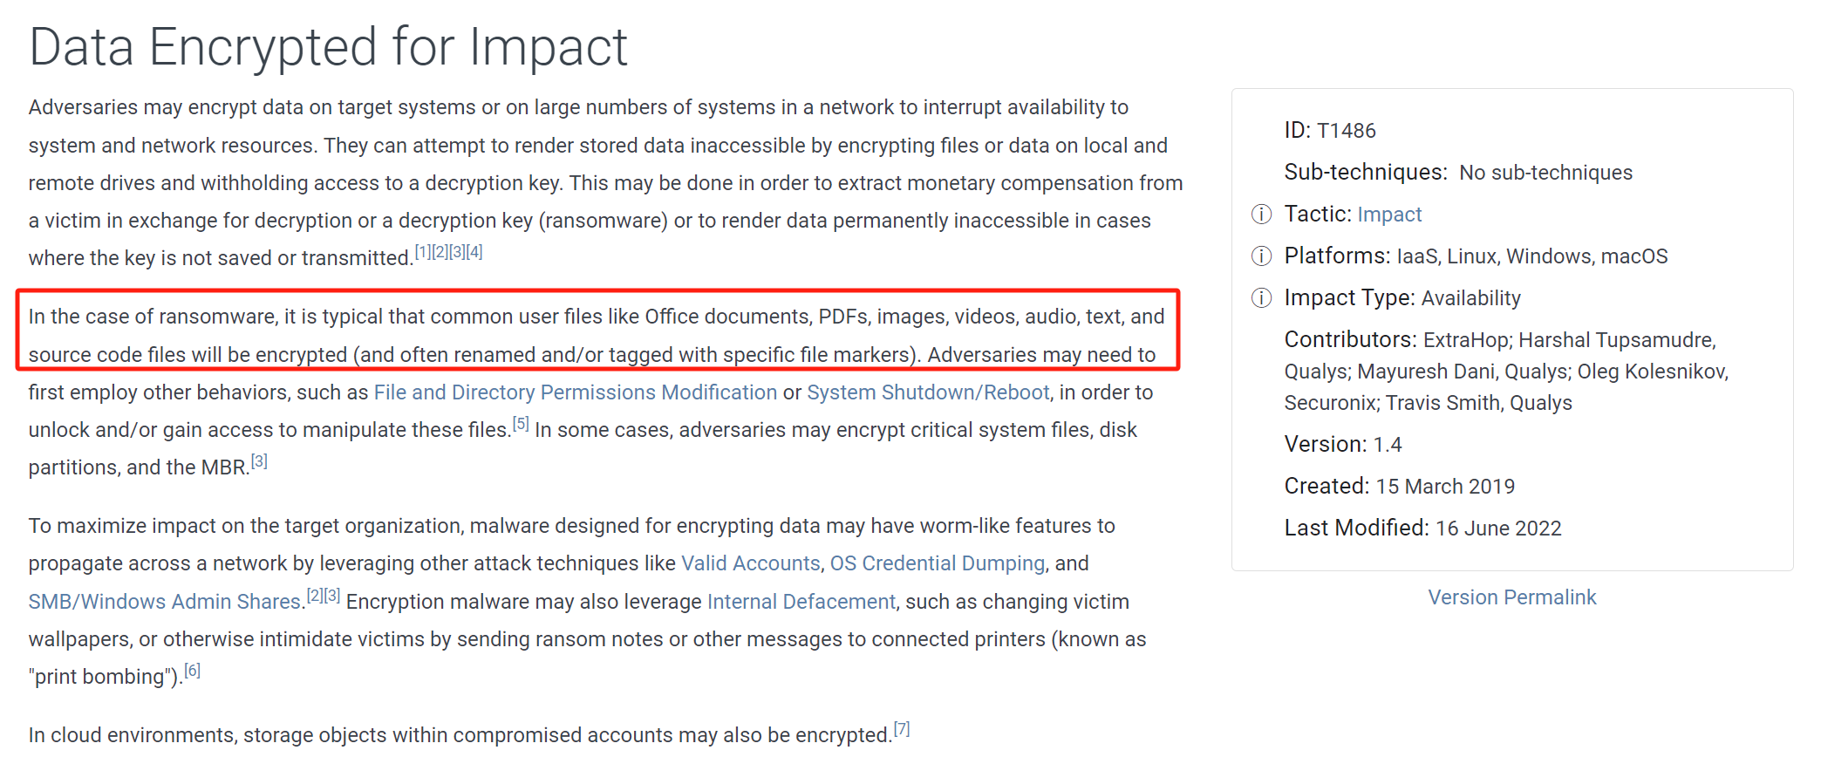
Data Encrypted for Impact
https://attack.mitre.org/techniques/T1486/

Slide 79
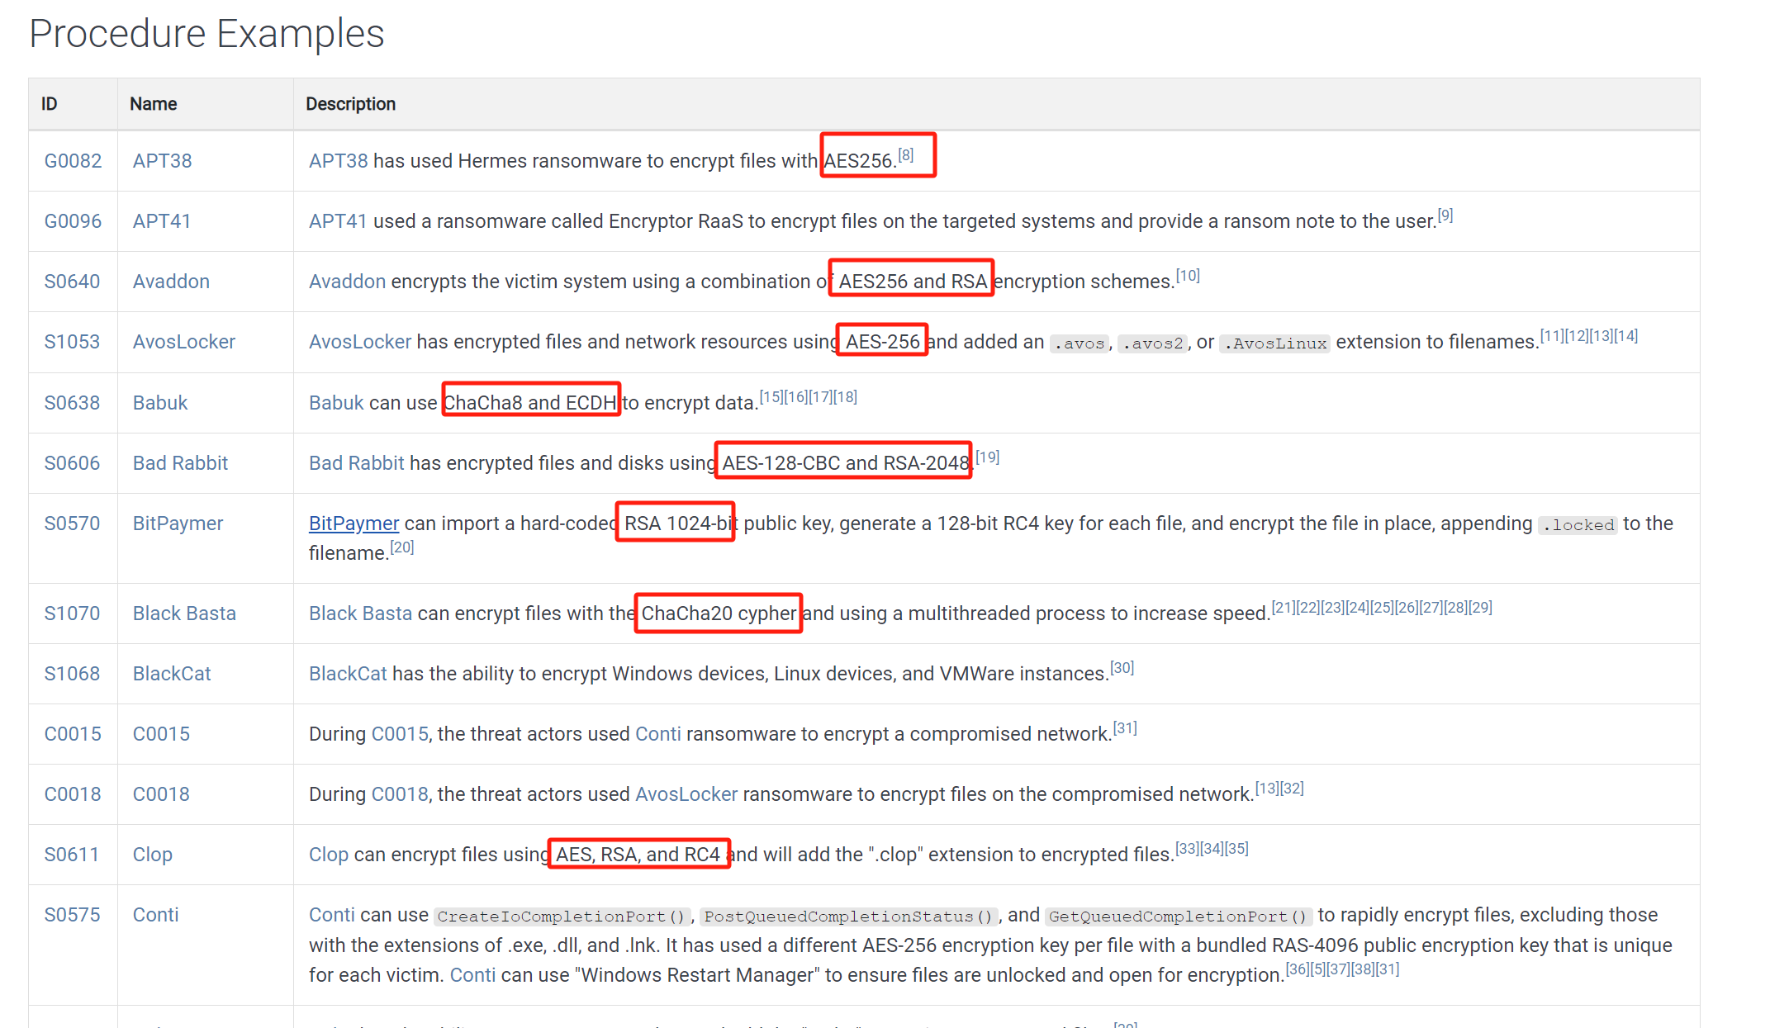
Data Encrypted for Impact
https://attack.mitre.org/techniques/T1486/

Slide 80
主观题
10分
讨论：针对勒索病毒，有哪些缓解和检测方法？
作答

Slide 81
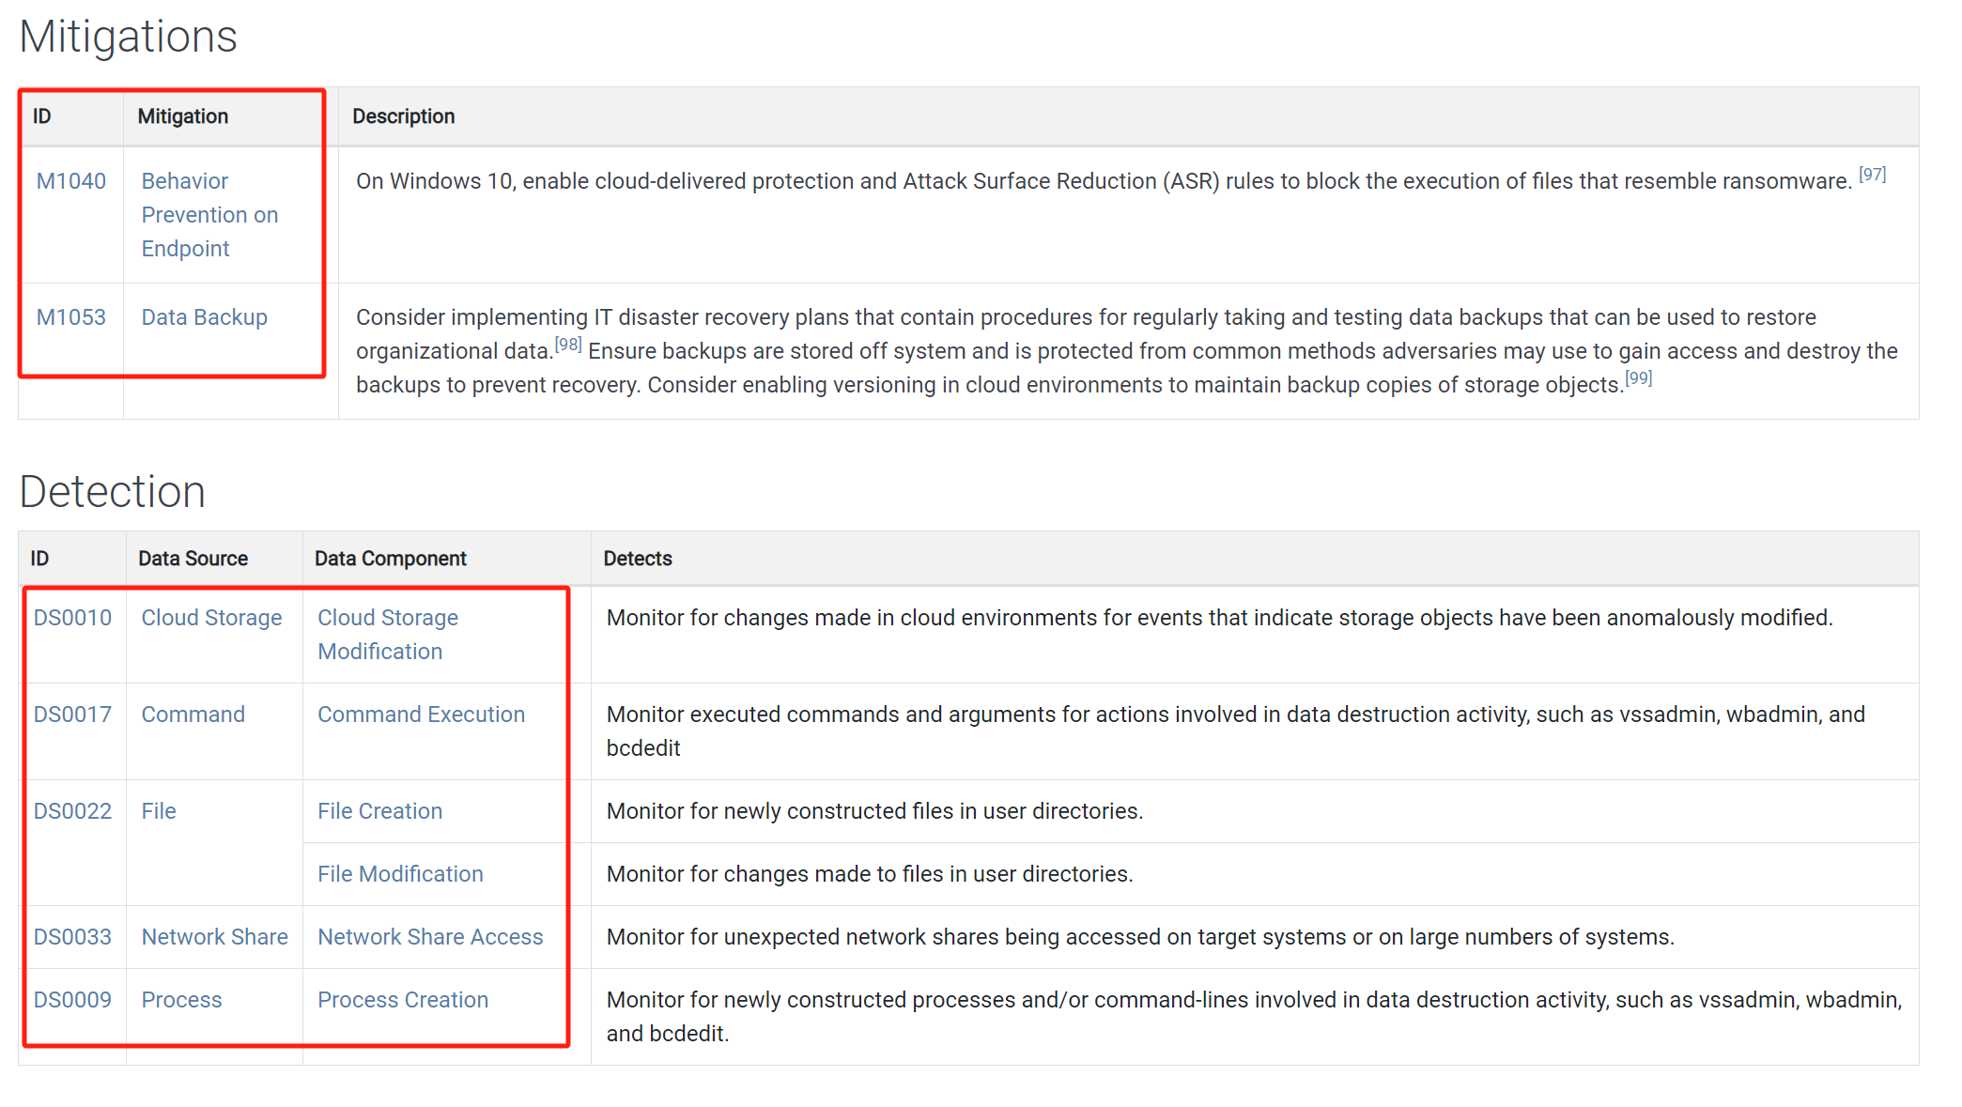
Data Encrypted for Impact

Slide 82
本章知识点
The Goal of Analyzing Encoding Algorithms
Simple Ciphers
重点：XOR、BASE64
Common Cryptographic Algorithms
难点：信息熵Entropy
Custom Encoding
Decoding
重点：自解密Self-decoding

Slide 83
恶意代码分析与防治技术 第13章 数据加密与解密
王志
zwang@nankai.edu.cn
南开大学 网络空间安全学院
2023-2024学年

